Slide 1
Operating System Principles - 2
Shyan-Ming Yuan
CS Department, NYCU
smyuan@gmail.com

Slide 2
Life Cycle of a Thread/Process
Thread (Process) execution consists of a cycle of
CPU execution and I/O wait.
They are called CPU burst and I/O burst, respectively.
Overall system throughput can be increased if some threads are in their CPU burst while others are waiting for I/O.
A scheduler is responsible for deciding what thread should run next.
If the current thread did not finish its CPU burst but it has run too long, the scheduler may preempt the current thread.
If a scheduler can preempt a thread and context switch to another thread then it is a preemptive scheduler.
Otherwise it is a non-preemptive.

Slide 3
CPU Scheduler & Dispatcher
The CPU scheduler selects a thread from threads in memory that are ready to execute, and allocates the CPU to it.
CPU scheduling decisions may take place when a thread:
1. Switches from running to waiting state (non-preemptive/system call)
2. Switches from running to ready state (preempted by time expiration)
3. Switches from waiting to ready (the running thread may then be preempted by a higher-priority thread)
4. Terminates (non-preemptive)
The dispatcher gives control of the CPU to the thread selected by the CPU scheduler. It includes the following actions:
switching context, switching to user mode and jumping to the proper location in the user program to restart that thread.
Dispatch latency is the time it takes for the dispatcher to stop one thread (process) and start running another.

Slide 4
Scheduling Criteria
CPU utilization is the percentage of CPU being busy
Throughput is the number of threads (processes) that complete their execution per time unit
Turnaround time is the total latency for executing a particular thread (process)
Waiting time is the total amount of time that a thread (process) has been waiting in the ready queue
Response time is the latency that a thread (process) takes from accepting a request until produces the first response (for time-sharing environment)
Time slice (or time quantum) is the maximum time a thread (process) can run before being preempted.

Slide 5
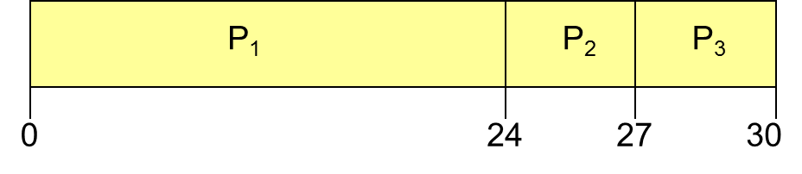
First-Come, First-Served (FCFS) Scheduling
Process Burst Time
P₁ 24
P₂ 3
P₃ 3
Assumed that the processes arrive in the order: P₁, P₂, P₃
The Gantt Chart for the schedule is:
Waiting time for P₁ = 0; P₂ = 24; P₃ = 27
Average waiting time: (0 + 24 + 27)/3 = 17

Slide 6
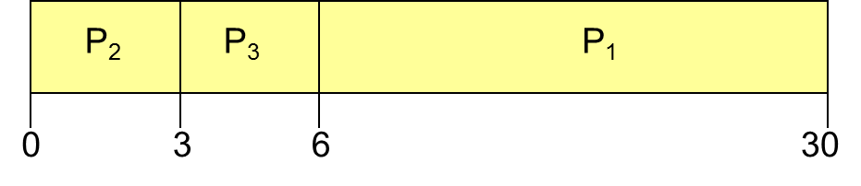
FCFS Scheduling (Cont)
When the processes arrive in the order
P₂ , P₃ , P₁
The Gantt chart for the schedule is:
Waiting time for P₁ = 6; P₂ = 0; P₃ = 3
Average waiting time: (6 + 0 + 3)/3 = 3
It is much better than the previous case
Convoy effect :
A short process may be slow down by a long process

Slide 7
Shortest-Job-First (SJF) Scheduling
Associate with each process the length of its next CPU burst.
Use these lengths to schedule the shortest process first
SJF is optimal with respective to average waiting time for a given set of processes.
The difficulty is knowing the length of the next CPU request

Slide 8
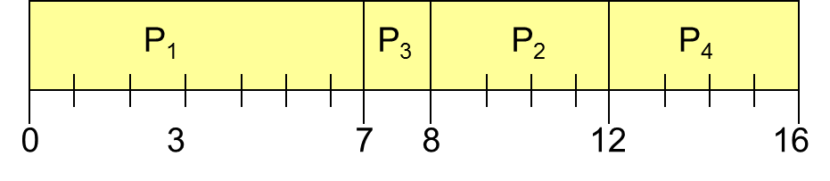
Example of Non-Preemptive SJF
Process Arrival Time Burst Time
P₁ 0.0 7
P₂ 2.0 4
P₃ 4.0 1
P₄ 5.0 4
SJF (non-preemptive)
Average waiting time = (0 + 6 + 3 + 7)/4 = 4

Slide 9
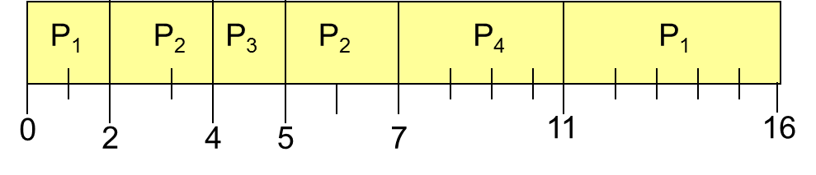
Shortest Remaining Time First (SRTF) (Preemptive SJF)
Process Arrival Time Burst Time
P₁ 0.0 7
P₂ 2.0 4
P₃ 4.0 1
P₄ 5.0 4
SRTF (preemptive SJF)
Average waiting time = (9 + 1 + 0 +2)/4 = 3

Slide 10
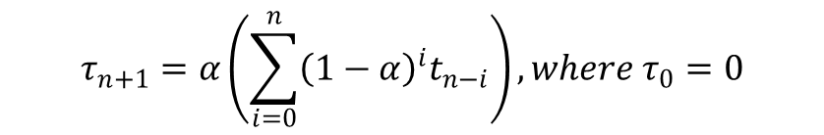
The Next CPU Burst
A typical mechanism to estimate the length of next CPU burst is:
A weighted exponential average of previous CPU bursts can be used.
The weight may be adjusted to weigh recent CPU bursts more or less than historical averages.
$$τ_{n+1}=αt_{n}+\left(1−α\right)\left(αt_{n−1}+\left(1−α\right)τ_{n−1}\right)=αt_{n}+α\left(1−α\right)t_{n−1}+{\left(1−α\right)}^{2}τ_{n−1}$$
$$τ_{n+1}=α\left(\sum_{i=0}^{n}{{\left(1−α\right)}^{i}t_{n−i}}\right), where τ_{0}=0$$

Slide 11
Round Robin (RR)
Each thread (process) gets a small unit of CPU time (time quantum), usually 10-100 milliseconds.
After this time has elapsed, the thread is preempted and added to the end of the ready queue.
If there are n threads in the ready queue and the time quantum is q, then each thread gets 1/n of the CPU time in chunks of at most q time units at once.
No thread waits more than (n-1)q time units.
Performance
q large ⇒ FIFO
q small ⇒ q must be large with respect to context switch, otherwise overhead is too high

Slide 12
Priority Scheduling
A priority number (integer) is associated with each thread
The CPU is allocated to the thread with the highest priority
It can be either preemptive or nonpreemptive
SJF is a priority scheduling where priority is the predicted next CPU burst time
Problem ≡ Starvation – low priority threads may never execute
Solution ≡ Aging – as time progresses increase the priority of each thread

Slide 13
Multilevel Queues
Ready queue is partitioned into separate queues:
foreground (interactive)
background (batch)
Each queue has its own scheduling algorithm
foreground – RR
background – FCFS
Scheduling between the queues
Fixed priority scheduling – serve all processes from foreground queue then background queue (May lead to starvation)
Time slice – each queue gets a certain amount of CPU time which it can schedule among its processes
80% to foreground in RR
20% to background in FCFS

Slide 14
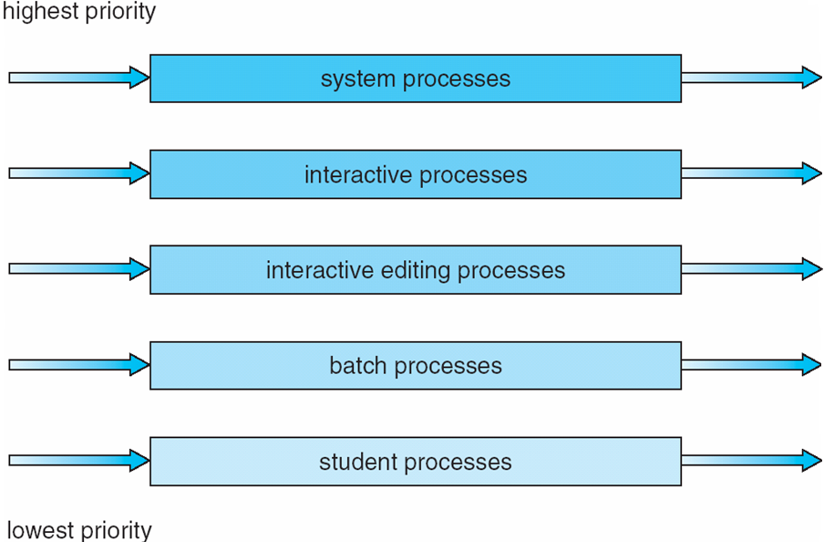
Multilevel Queue Scheduling

Slide 15
Multilevel Feedback Queues
A process can move between the various queues
aging can be implemented in this way
Multilevel-feedback-queue scheduler defined by the following parameters:
number of queues
scheduling algorithms for each queue
methods used to determine when to upgrade a process
methods used to determine when to demote a process
methods used to determine which queue a process will enter when that process needs service

Slide 16
Example of Multilevel Feedback Queue
Three queues:
Q₀ – RR with time quantum 8 milliseconds
Q₁ – RR with time quantum 16 milliseconds
Q₂ – FCFS
Scheduling
A new job enters in the rear of the queue Q₀.
When a Q₀ job gains CPU, it receives 8 milliseconds.
If it does not finish in 8 milliseconds, the job is moved to the rear of the queue Q₁.
When a Q₁ job gains CPU, it receives 16 milliseconds.
If it still does not complete, it is preempted and moved to the rear of the queue Q₂.
When a Q₂ job gains CPU, it runs until it finishes.

Slide 17
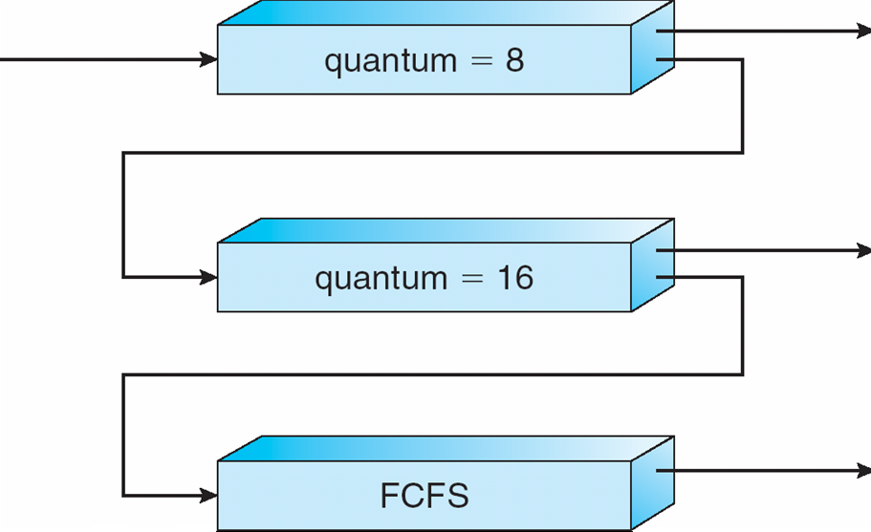
Multilevel Feedback Queues

Slide 18
Real Time Applications
Time critical applications usually require guaranteed response.
A start time is the time at which a task must start in response to some event, such as an interrupt from a sensor.
A deadline is the time at which the task must complete.
A hard deadline is one in which there is no value if the deadline is missed.
A soft deadline is one where there is decreasing value in the computation as the deadline slips.

Slide 19
Real-Time (RT) Systems
A real-time (RT) system must be able to respond to events quickly.
Hard real-time systems can guarantee response times.
Soft real-time systems provide guaranteed responses at best effort.
Real-time operating systems usually use priority schedulers.
All interrupt services must have a guaranteed maximum service time.
Efficient memory allocation, multi-threaded execution, and preemptable system calls are also supported.
RT processes must be fully loaded into the system’s memory.
Otherwise, deadlines may be violated because the OS is busy doing something else.

Slide 20
RT Processes
A tasks may be a terminating process, which run and then exit.
Its deadline is the latest time that it must exit.
A task may also be nonterminating process.
It may run for a long time but perform periodic operations, such as encoding and decoding audio and video.
Its deadline is not the time to exit but rather the time by which results have to be ready for each period of execution.
e.g., decode a video frame every 33 ms (30 frames per second.)
Compute time is the time to perform each periodic event.
Deadline is the time that each periodic result must be ready.
If T = period, D = deadline, C = compute time,
C ≤ D ≤ T

Slide 21
RT Scheduling
Earliest Deadline First (EDF) Scheduling:
Each RT process tells OS its deadline
Scheduler picks the process that has the nearest deadline to run.
In general, a process can run to completion if it has an earlier deadline.
However, it may be preempted if a process with an even earlier deadline starts.
Least Slack First (LSF) Scheduling:
Consider both remaining compute time and deadline.
Look not only at the deadline but how much a process can be deferred.
slack = (time to deadline) – (amount of remaining computation)
E.g., suppose C = 5 ms, D = 20 ms from now, then slack = D - C = 15 ms

Slide 22
LSF vs. EDF
Earliest Deadline First
The earliest deadline process always finish before others.
Least Slack First can get a more fared (balanced) result.
The differences to deadlines can be balanced If there’s not enough time for everything:
In EDF, only some early deadline processes may finish.
In LSF, all deadlines may be missed but roughly by the same amount.

Slide 23
Rate Monotonic Scheduling
Assign static priorities to periodic processes according to their periods.
Highest frequency (smallest period) process gets the highest priority
Lower frequency processes get lower priorities
All periodic RT processes must have known periods and are running at the same time.
Scheduling periodic RT processes via a simple priority scheduler.
If two processes have the same priority, they can round robin.
Rate monotonic scheduling is optimal.
If it is possible for all deadlines to be met then they will be met with rate monotonic scheduling.
Liu, C. L.; Layland, J. (1973), "Scheduling algorithms for multiprogramming in a hard real-time environment", Journal of the ACM, 20 (1): 46–61

Slide 24
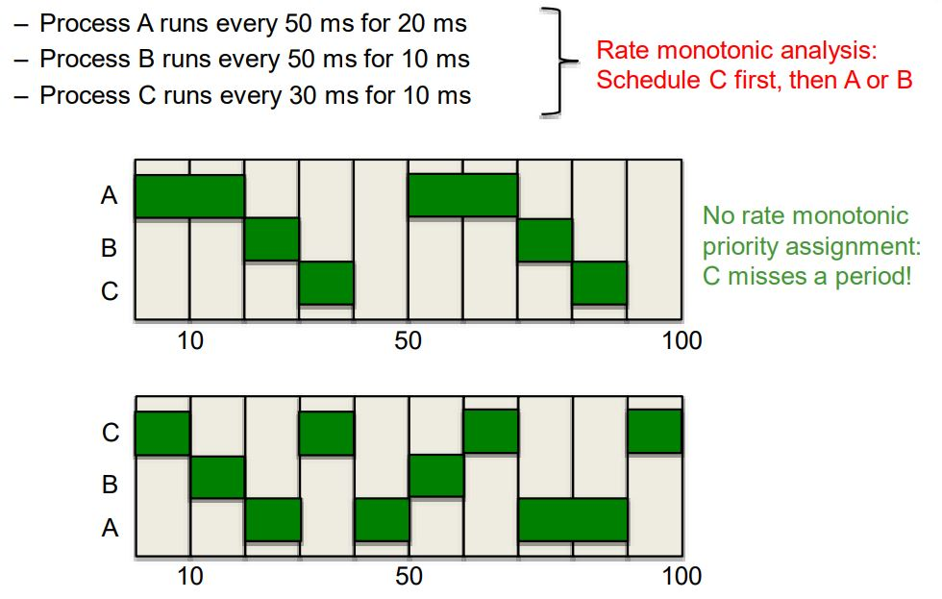
Rate monotonic example

Slide 25
CPU Memory Access
A CPU executes a process by reading instructions.
These instructions reside in memory and they may request the processor to read and write other memory locations.
Each instruction and each datum is read from a memory location (an address.)
Addresses may be either absolute or relative.
An absolute address is the actual memory location that is being referenced.
A relative address is expressed as an offset to the contents of a register.
The most common relative addressing mode is PC-relative, where the address is expressed as an offset to the program counter.

Slide 26
Binding of Instructions and Data to Memory
Address binding of instructions and data to memory addresses can happen at three different stages.
Compile time: If memory location known a priori, absolute code can be generated.
Recompilation is needed if starting location changes.
Load time: Must generate relocatable code if memory location is not known at compile time
Execution time: Binding delayed until run time if the process can be moved during its execution from one memory segment to another.
Need hardware support for address maps (e.g., base and limit registers)

Slide 27
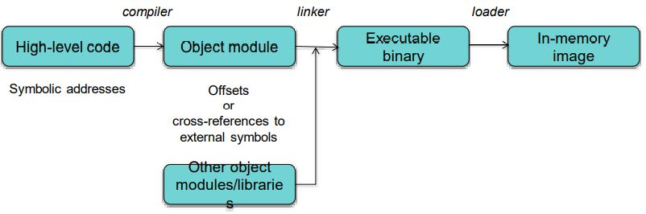
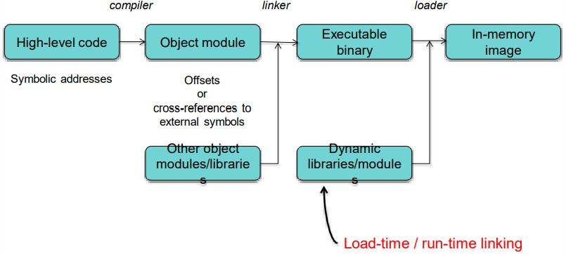
Static & Dynamic Linker
Static Linker
Dynamic Linker

Slide 28
How do programs specify memory access?
Absolute code
If you know where the program gets loaded (any relocation is done at link time)
Dynamically relocatable code
Relocated at load time
Position independent code
All addresses are relative (e.g., gcc –fPIC option)
Or … use logical addresses
Absolute code with addresses translated at run time
Need special memory translation hardware
E.g. memory management unit (MMU)

Slide 29
Logical vs. Physical Address Space
The concept of a logical address space that is bound to a separate physical address space is central to proper memory management
Logical address – generated by the CPU (also called virtual address.)
Physical address – address seen by the memory unit
In compile-time and load-time address-binding schemes, logical and physical addresses are the same.
In execution-time address-binding scheme, logical (virtual) and physical addresses can be different.
In MMU scheme, the value in the relocation register is added to every address generated by a user process at the time it is sent to memory.
The user program deals with logical addresses only it never sees the real physical addresses.

Slide 30
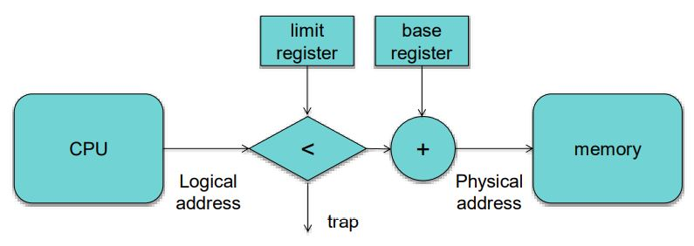
MMU Based Relocatable Addressing
Base & limit registers inside MMU
Physical address = logical address + base register
But first check that: logical address < limit
MMU

Slide 31
Program Linking
An executable program is typically built from several source files and makes references to library functions.
A linker is responsible for combining these separately-compiled files and filling in undefined symbols in one module with their definitions from another module.
Static linking is the case where a linker resolves all symbols and includes all the code that is needed to run the program within the executable file.
The operating system's program loader can load it into memory and run it.
Dynamic linking can leave certain libraries and symbols unresolved but are loaded on demand until they are referenced in runtime.
The dynamic linker usually links the program with stub libraries whose only task is to load the actual libraries.

Slide 32
Dynamic Loading
A subroutine is not loaded until it is called
Better memory-space utilization
Unused routine is never loaded
Useful when large amounts of code are needed to handle infrequently occurring cases
No special support from the operating system is required
It can be implemented through proper program design

Slide 33
Shared Library
Dynamic linking enables the use of shared libraries.
The same block of code containing the library can be referenced by multiple processes that need it.
If a unloaded shared library is referenced, the program loader will allocate memory and load it from the library file.
If a loaded library is referenced, the program loader will replace the process' references to the memory that library was loaded.
Since a shared library may be loaded in different memory location at each memory residency, it must be compiled to use relative addressing (also called position independent code).
The OS keeps track of the number of references to each shared library.
When the last process that uses a shared library terminates, the library is then unloaded from memory.

Slide 34
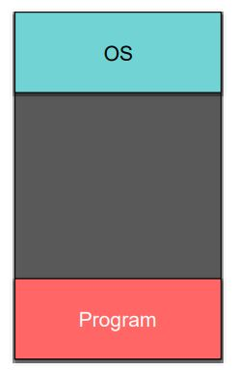
Memory Management
The simplest approach is the single partition multiprogramming.
Only a single program is loaded in memory at any given time.
The program shares memory with the OS and nothing else.
Absolute addressing is no problem.
Many older systems (e.g. MSDOS) use this approach.

Slide 35
Swapping
A process can be swapped temporarily out of memory to a backing store, and then brought back into memory for continued execution.
A backing store can be a fast disk large enough to accommodate copies of all memory images for all users.
It must provide direct access to these memory images.
Roll out, roll in is a swapping variant used for priority-based scheduling.
Lower-priority processes are swapped out so higher-priority processes can be loaded and executed.
Major part of swap time is the total transfer time that is directly proportional to the amount of memory swapped.
Modified versions of swapping are found on many systems.
i.e., UNIX, Linux, and MS Windows
OS maintains a ready queue of ready-to-run processes which have memory images on disk.

Slide 36
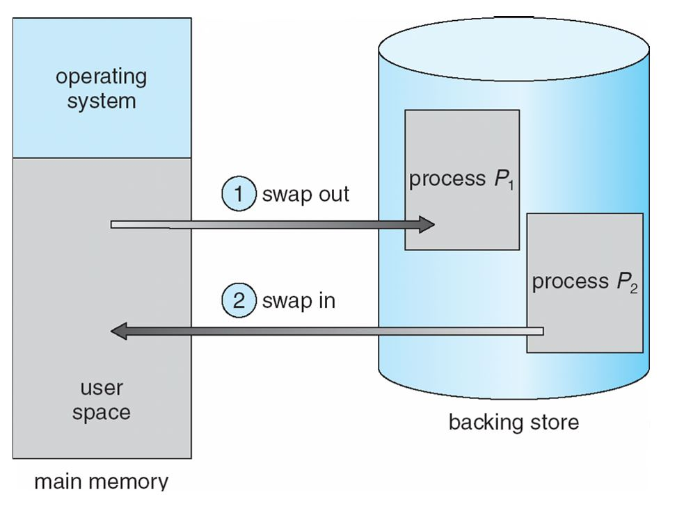
Schematic View of Swapping

Slide 37
Multiple Fixed Partitions
Divide memory into predefined partitions (segments)
Partitions don’t have to be the same size
For example: a few big partitions and many small ones
New process gets queued for a partition that can hold it
Unused memory in a partition is wasted: internal fragmentation
Unused partitions are wasted also: external fragmentation
Process takes up a contiguous region of memory (Contiguous allocation.)
Relocation registers (MMU) are used to protect user processes from each other and from changing operating-system code and data.
Base register contains value of smallest physical address.
Limit register contains range of logical addresses.
Every logical address must be less than the value in limit register .

Slide 38
Multiple Variable Partitions (MVP)
A Hole is a block of available memory.
Holes of various size are scattered throughout memory.
When a process arrives, it is allocated to a large enough hole to accommodate it.
OS keeps track of all allocated partitions and free partitions (holes.)
OS
OS
OS
OS
process 5
process 5
process 5
process 5
process 9
process 9
process 8
process 10
process 2
process 2
process 2
process 2

Slide 39
Allocation Algorithms for MVP
How to satisfy a request of size n from a list of free holes.
First-fit: allocates the first hole that is big enough.
Best-fit: allocates the smallest hole that is big enough.
It must search entire list, unless holes are ordered by size.
It produces smallest and maybe useless (external fragmentation) leftover holes.
To avoid creating a very small useless hole, the smallest big enough hole may be assigned to the new process as a whole (internal fragmentation).
Worst-fit: allocates the largest hole
It must also search entire list, unless holes are ordered in descending order.
It always produces the largest leftover hole.
In general, first-fit and best-fit perform better than worst-fit in terms of speed and storage utilization

Slide 40
Page-Based Memory Management
Logical address space of a process can be noncontiguous.
Physical memory is divided into fixed-sized blocks called frames.
In general, frame size is power of 2 (512 bytes ~8,192 bytes.)
Logical memory of each process is also divided into blocks of same size called pages.
OS must keep track of all free frames.
To run a program of n pages, n free frames must be located.
Page table is used to translate logical to physical addresses.
External fragmentation can be eliminated.
Internal fragmentations may exist.
The last page is usually not a full page.
In average, each process has a half page internal fragmentation.

Slide 41
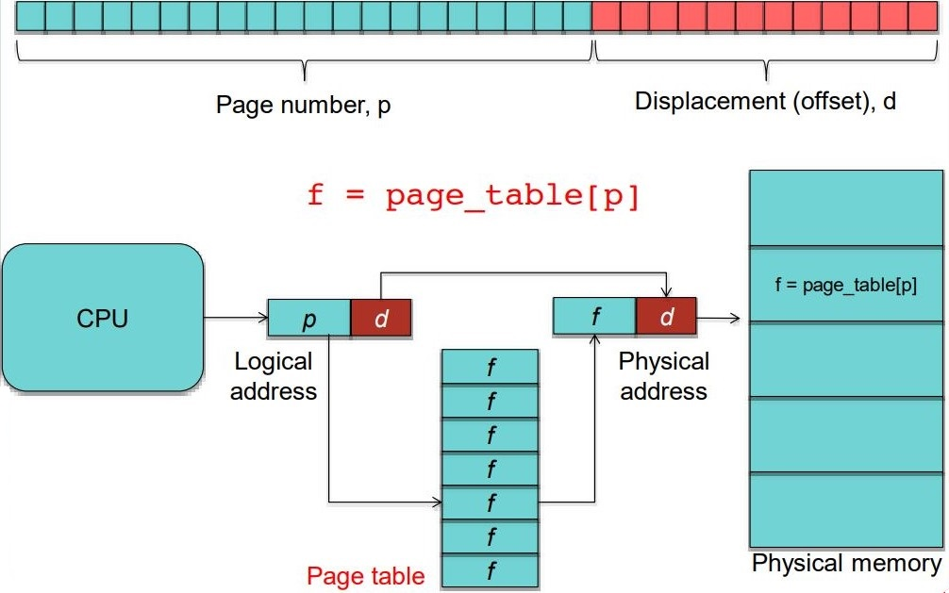
Page Translation

Slide 42
Implementation of Page Table
Page table is kept in main memory
Page-table base register (PTBR) points to the page table
Page-table length register (PRLR) indicates size of the page table
Every data/instruction access requires two memory accesses.
One for the page table and one for the data/instruction.
The two memory access problem can be solved by the use of a special fast-lookup hardware cache called associative memory or translation look-aside buffers (TLBs.)
Some TLBs store address-space identifiers (ASIDs) in each TLB entry.
This can uniquely identify each process to provide address space protection for that process.

Slide 43
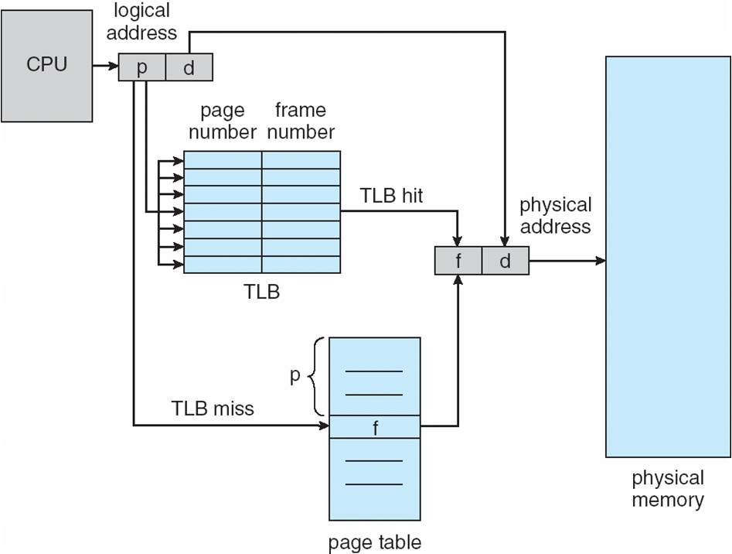
Paging With TLB

Slide 44
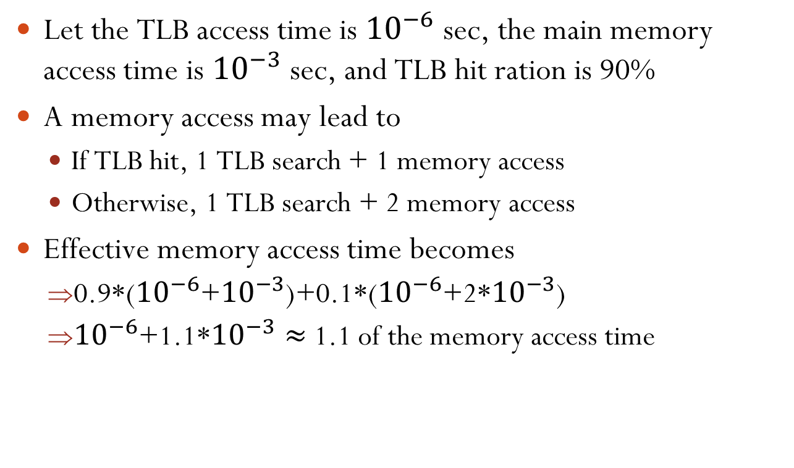
Effective Access Time with TLB
Let the TLB access time is ${10}^{−6}$ sec, the main memory access time is ${10}^{−3}$ sec, and TLB hit ration is 90%
A memory access may lead to
If TLB hit, 1 TLB search + 1 memory access
Otherwise, 1 TLB search + 2 memory access
Effective memory access time becomes
0.9*(${10}^{−6}$+${10}^{−3}$)+0.1*(${10}^{−6}$+2*${10}^{−3}$)
${10}^{−6}$+1.1*${10}^{−3}≈$ 1.1 of the memory access time

Slide 45
Paging for Large Address Space
Most processes use only a small part of their address space.
Keeping an entire page table is wasteful.
Example: 32-bit system with 4KB pages:
20-bit page table ⇒ 2²⁰ = 1,048,576 entries in the page table
Three common approaches to deal with large address space are:
Hierarchical Paging uses multilevel page tables
Hashed Page Tables
Inverted Page Tables

Slide 46
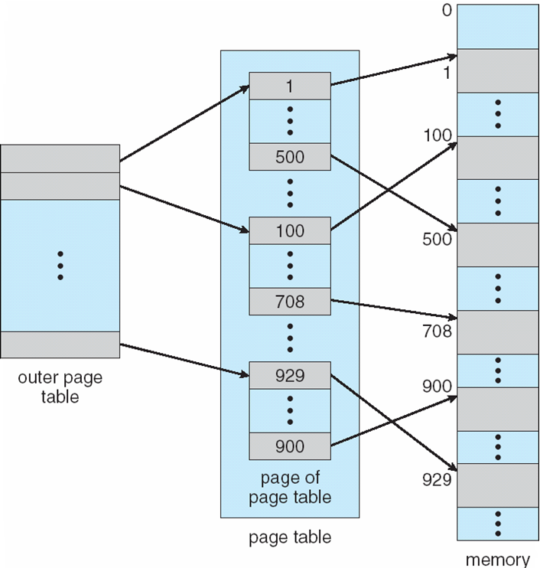
Hierarchical Paging
Break up the logical address space into multiple page tables
A simple technique is a two-level page table
A 32-bit logical address of 1K page size is divided into:
a 22-bit page number
a 10-bit page offset
The page number is then paging into:
a 12-bit outer page number
a 10-bit inner page number

Slide 47
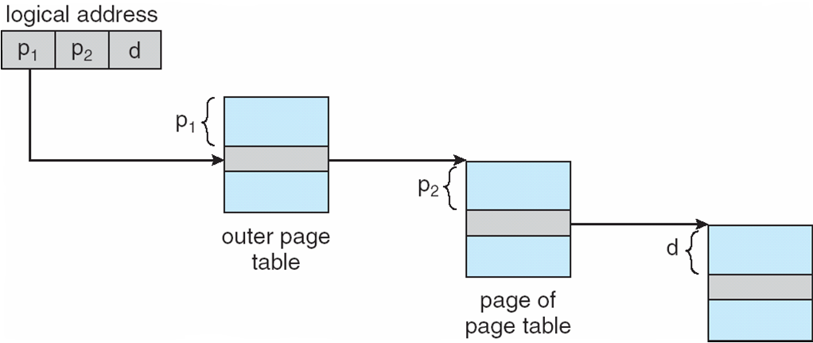
Address-Translation in Two-Level Paging Scheme
page number
page offset
p₁
p₂
d
12
10
10

Slide 48
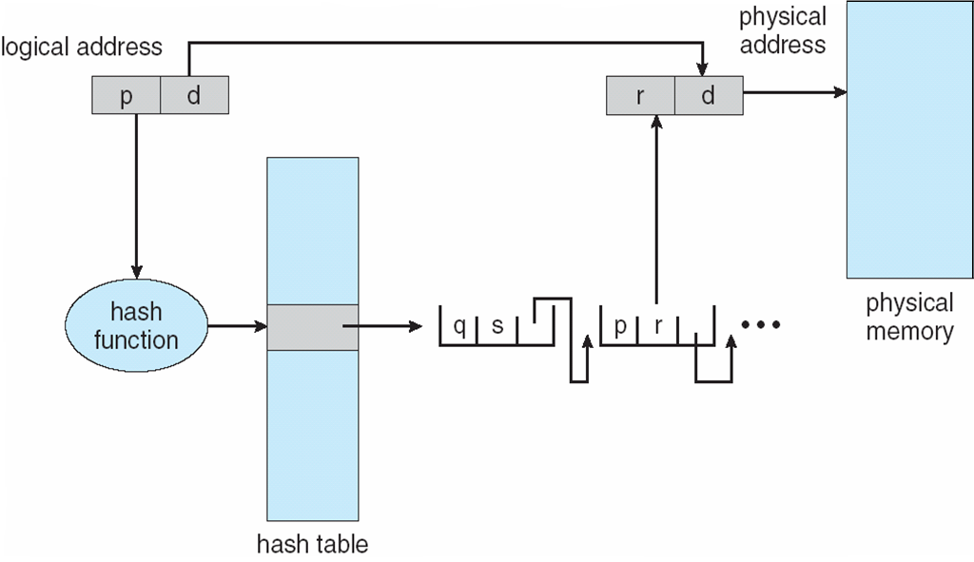
Hashed Page Tables
Common in address spaces > 32 bits
The virtual page number is hashed into a page table.
This page table contains a chain of elements hashing to the same location.
Virtual page numbers are compared in this chain searching for a match.
If a match is found, the corresponding physical frame is extracted.

Slide 49
Inverted Page Table
Used when the # of frames is more manageable than the # of pages.
The i-th entry contains which page is in frame i.
It also includes information about the process that owns that page.
It can reduce memory needed to store page tables, but increases time needed to search the table when a page reference occurs.
Hash table can be used to limit the search to one or at most a few page table entries.

Slide 50
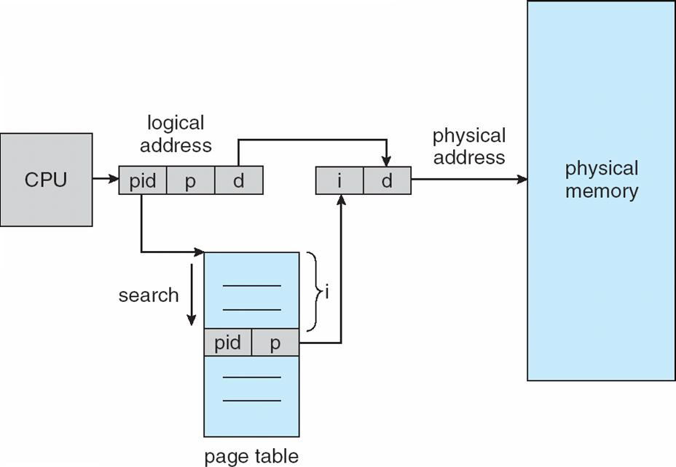
Inverted Page Table Architecture
Inverted page table

